Slide 1

HOUSE PRICE PREDICTOR

Slide 2





OUTLINE
TOOLS USED
WHAT IT DOES?
HOW IT WORKS?
PROJECT SUMMARY
TECHNOLOGY USED

Slide 3

INTRODUCTION
Problems Faced During Buying A House ->
Very stressful task.
Buyers are not aware of the factors affecting house prices.
It is very hard to compel the buyer.
Both the seller and the buyer are dependent on the real estate agents for the successful completion of the task. This increases the price of the house.

Slide 4


Problems Faced During Buying A House -> (Contd…)
They believe that the price depends upon –
Number of bedrooms
Square foot Area
Neighborhood
But it actually depends upon –
Number of storeys
Grade
Rooms on one floor

Slide 5

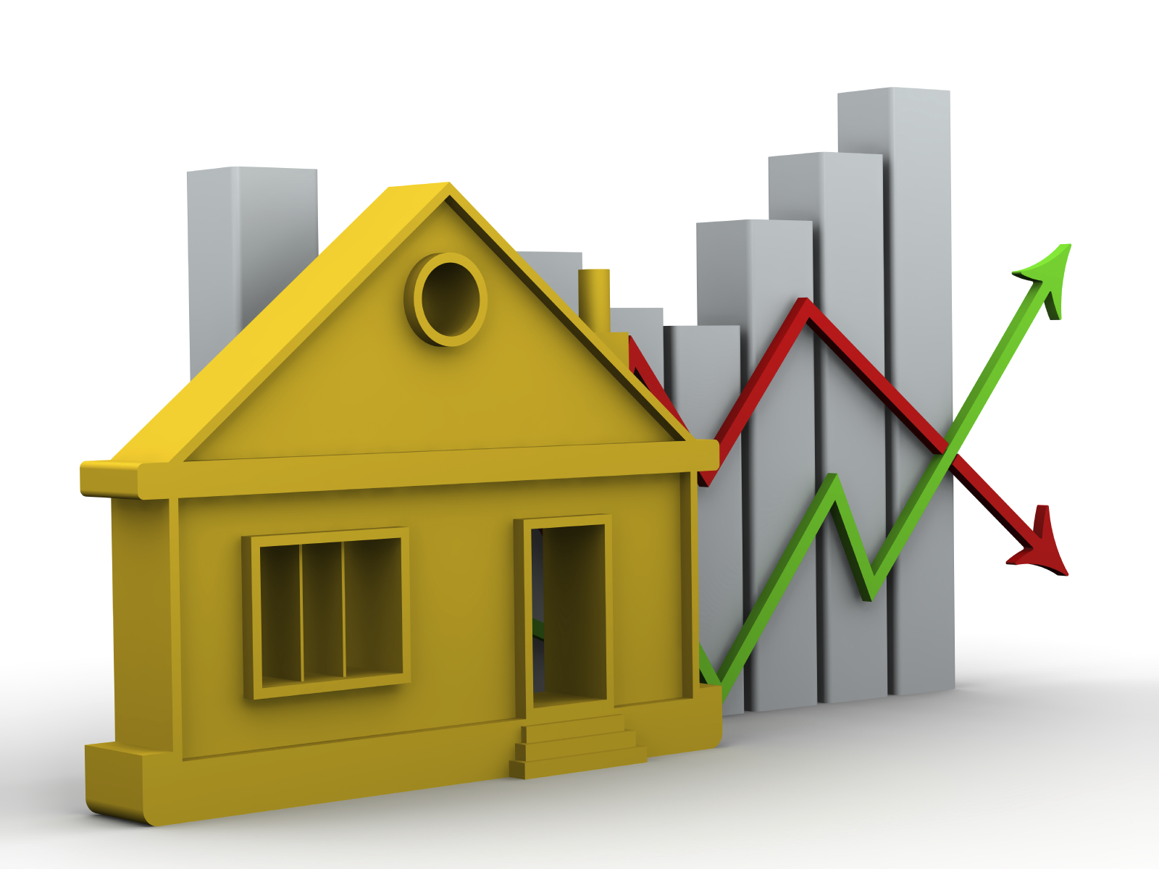
PROJECT SUMMARY
Our project is a machine learning model/program which will make predictions based on certain categories/specifications of the house.
It has a very user-friendly interface with many operations to perform from the user as well as from the admin side.

Slide 6

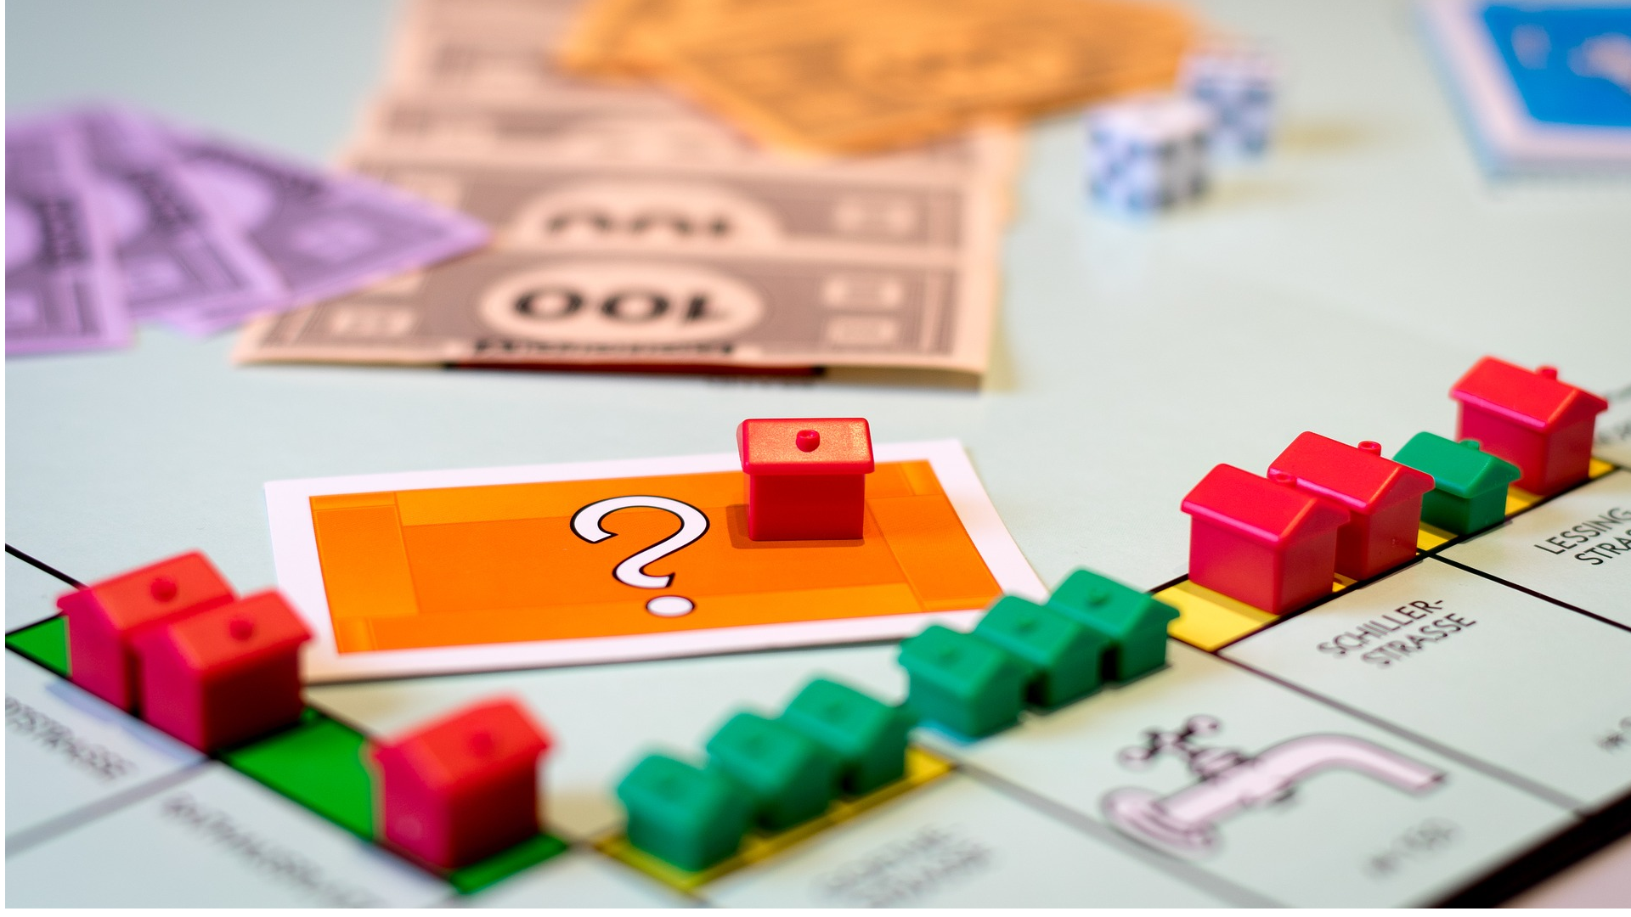
PROJECT SUMMARY (contd…)
Accurate predictions using machine learning is made possible by utilizing a large amount of dataset of King Country, U.S.A consisting of more than 21,000 entries.
The various features include location(latitude, longitude), number of bedrooms, bathrooms & floors, condition & grade of the house and many more.

Slide 7


TECHNOLOGY USED
MACHINE LEARNING
In the words of Tom Mitchell – “A computer program is said to learn from experience E with respect to some class of tasks T and performance measure P, if its performance P at tasks T, improves with experience E.”
Or simply, Machine learning is the study of computer algorithms that allow computer programs to automatically improve through experience.

Slide 8


TECHNOLOGY USED (contd…)
MACHINE LEARNING
Example – Predicting whether the given object is a pen or a pencil.
E = Experience of predicting many pens & pencils.
T = Task to predict a pen or a pencil.
P = The probability of accurate prediction of a pen or a pencil

Slide 9


TECHNOLOGY USED (contd…)
SUPERVISED LEARNING & REGRESSION
Since we have trained our data set and provided it with a fair enough idea of what our final prediction will be like, our process or machine learning is called supervised machine learning.
The model that we used is called Linear Regression (sometimes also called Multiple Regression), which is the process in which the value of a dependent variable is predicted based on one or more independent variables.

Slide 10

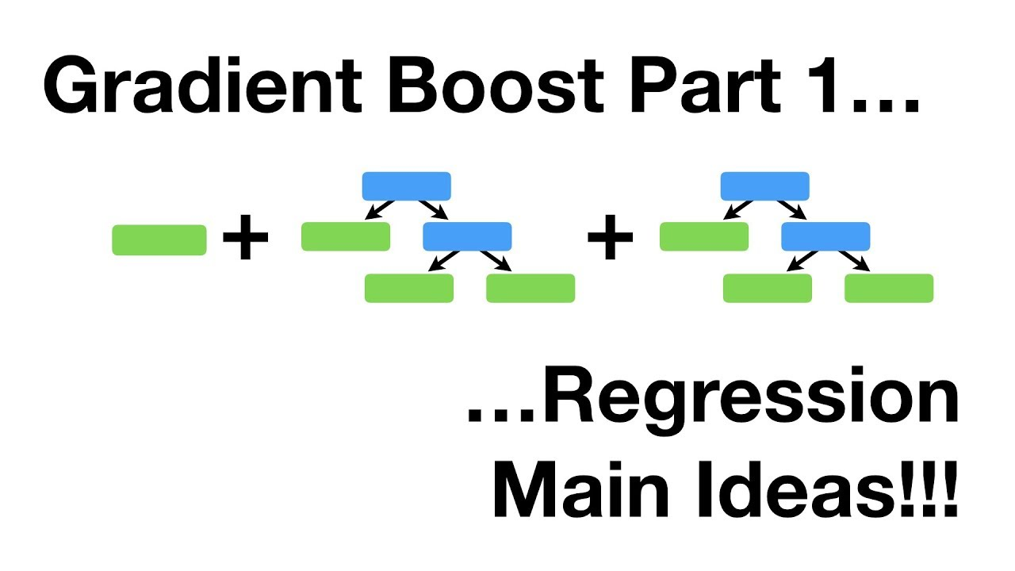
TECHNOLOGY USED (contd…)
GRADIENT BOOSTING REGRESSOR
“An efficient algorithm for converting relatively poor hypotheses into very good hypotheses.”
The idea of boosting came out of the idea of whether a weak learner can be modified to become better.

Slide 11





TOOLS USED
PYTHON Programming Language
Google Colab Software
SkLearn Library
Graph Plotting using MatPlotLib

Slide 12
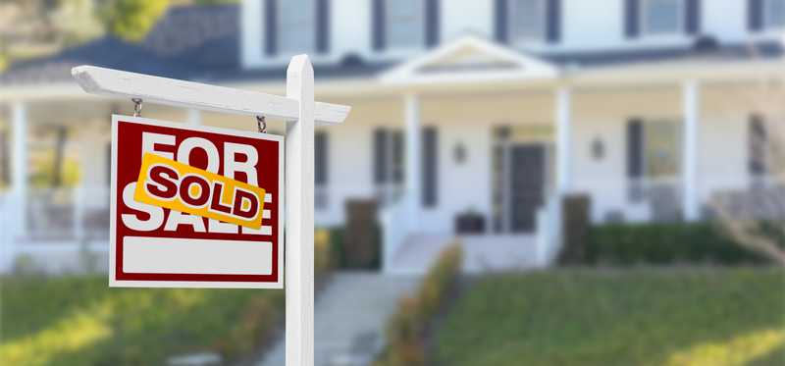
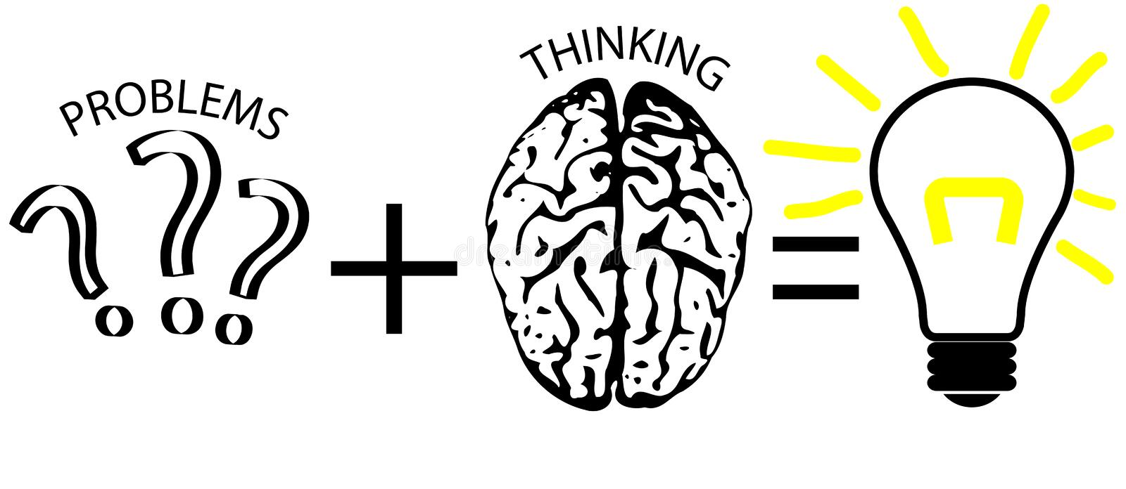
WHAT IT DOES ?..
Predicting house prices accurately for helping both buyer & seller.
Plot various graphs to show the relationship of all the features with the price of the house.
Provide different options for both user & admin.
Clear the confusion from the mind of buyer.
Make the process of buying house smooth.

Slide 13
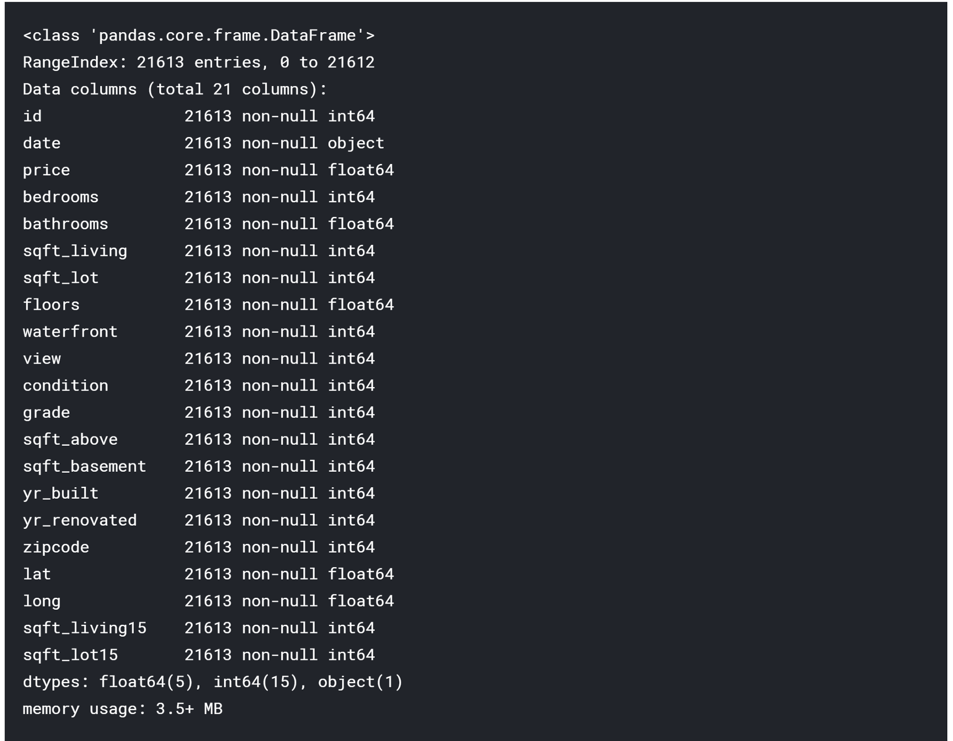
HOW IT DOES ?..
Collecting data :
KC Housing Dataset (King Country, USA) from Kaggle.
21,000+ entries.
15+ deciding features.
8:2 ratio separation for training & testing.
Numerous plots to understand the data.

Slide 14
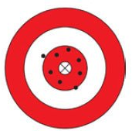
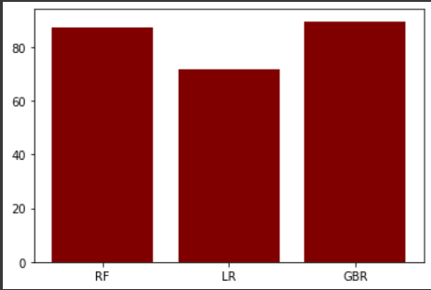
HOW IT DOES ?..(contd…)
2. Training Model :
Trained Model using Linear Regression Model, Random Forest & Gradient Boosting Regressor.
GBR proved to be the best algorithm.
Around 97% training accuracy.

Slide 15

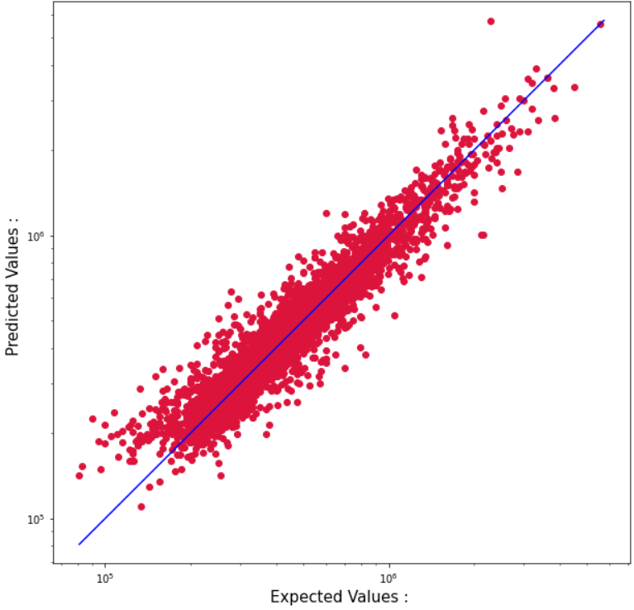
HOW IT DOES ?.. (contd…)
3. Testing Model :
Testing the defined algorithm with the testing dataset.
Making predictions based on the input by the user.
Plotting Graph of Actual vs Predicted values.

Slide 16
Identify Data
Prepare Data
Select ML Algorithm
Train
Evaluate
Deploy
Evaluate Final Predictions
ARCHITECTURE DIAGRAM

Slide 17

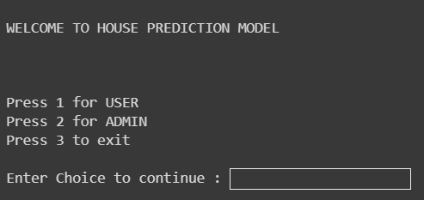
HOW IT LOOKS ??
MAIN MODULE

Slide 18
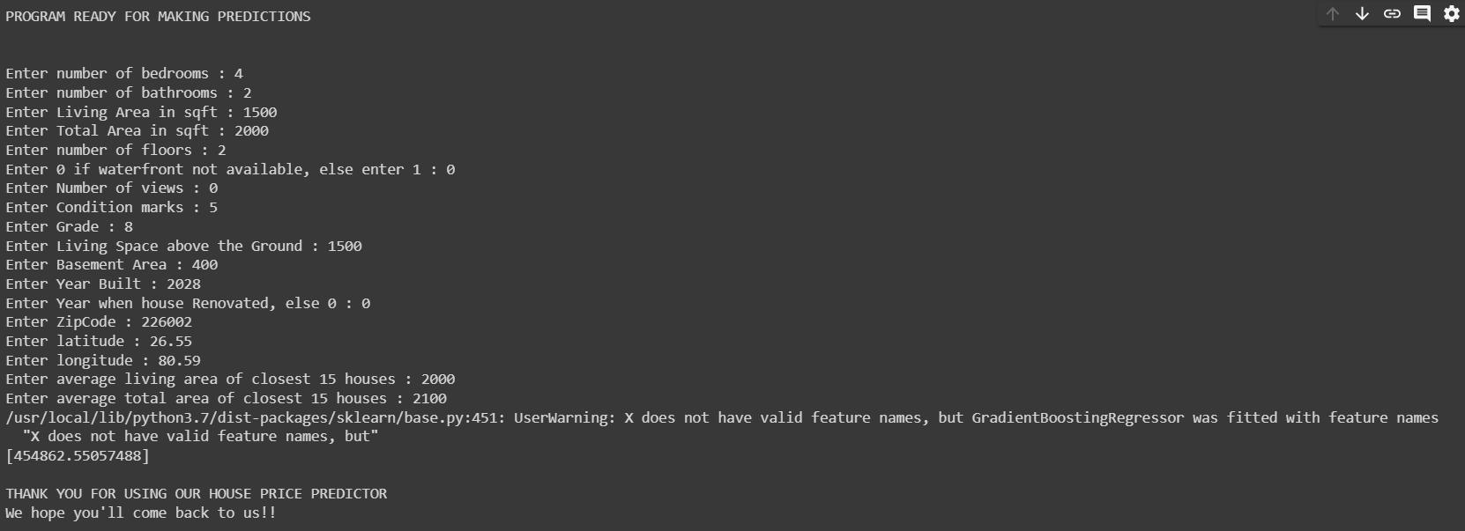
HOW IT LOOKS ??
USER MODULE

Slide 19
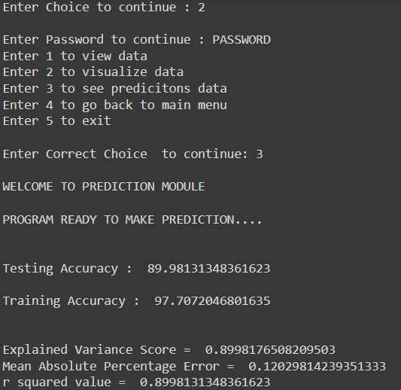
HOW IT LOOKS ??
ADMIN MODULE

Slide 20

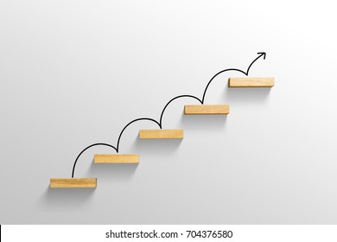



FUTURE WORK
Our model has quite high accuracy score of more than 90%.There is still room for improvement.
The model should check for new data, once in a month & incorporate them to expand the data set and produce better results.
We can also develop it into a GUI application to make it more user-friendly.
We can make a system to authenticate the entries being fed into the dataset.

Slide 21
REFERENCES -
International Journal of Advanced Computer Science and Applications
https://www.kaggle.com/shivachandel/kc-house-data
https://www.geeksforgeeks.org/python-linear-regression-using-sklearn/
https://www.geeksforgeeks.org/introduction-to-seaborn-python/
https://www.youtube.com/watch?v=0Lt9w-BxKFQ

Slide 22


